Slide 1
REST, resources and Rails
Moskovchuk Serhiy
2/21/2012

Slide 2
Agenda
REST
REST in Rails
REST routing

Slide 3
REST What is REST? REST Constraints Why REST? REST Resource

Slide 4

WHAT IS REST?
Coined by Roy Fielding (2000)
REST means
Representational State Transfer
REST applies some constraints to the architecture of your application
REST describes an architecture paradigm for web applications that request and manipulate web resources using the standard HTTP methods GET, POST, PUT and DELETE.

Slide 5
REST CONSTRAINTS
The REST architectural style describes the following six constraints applied to the architecture
Client–server
Stateless
Cacheable
Layered system
Code on demand (optional)
Uniform interface

Slide 6
WHY REST?
Clean URLs.
Different Response Formats
Less Code
CRUD-oriented Controllers.
Clear Application Design
Standartization is good
Why use so many different functions when you always do the same (CRUD’ing objects)

Slide 7
REST RESOURCE
Everything is a “resource”
Resource = thing exposed by the system to the outside world
Everything is a resource
http://www.frailers.net/users/1
Independent from its representation
user.html => http://www.frailers.net/users/1
user.js => http://www.frailers.net/users/1
A resource in the context of REST is a URL-addressable entity that offers interaction via HTTP.
Resources can be represented in different formats like HTML, XML or RSS, depending on what the client requests.
Each resource is represented as a unique URL.

Slide 8

REST IN RAILS
* Not on Rails

Slide 9
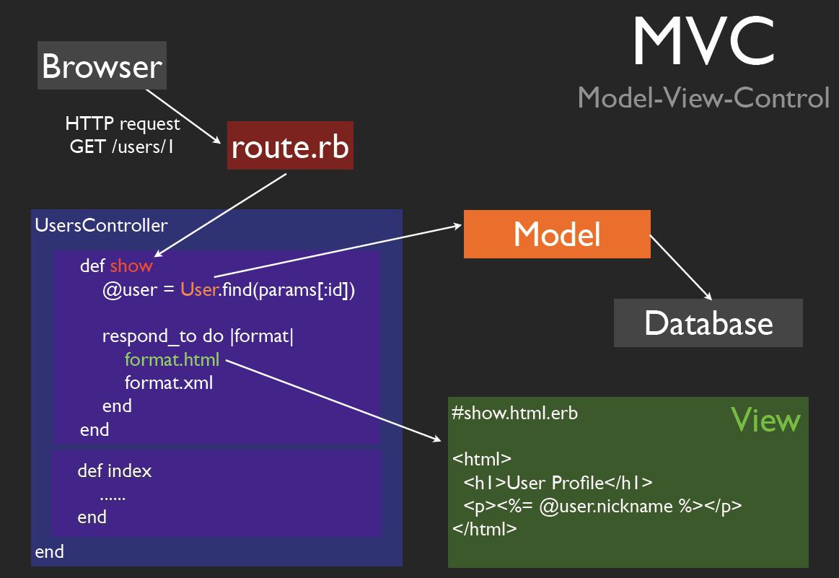
REST IN RAILS

Slide 10
REST IN Rails
REST is still MVC-based and from an technical point of view, can be reduced to the following new techniques:
The usage of respond to in controller code.
New helper methods for links and forms.
The usage of URL methods in controller redirects.
New routes that are generated from the method resources in routes.rb.

Slide 11
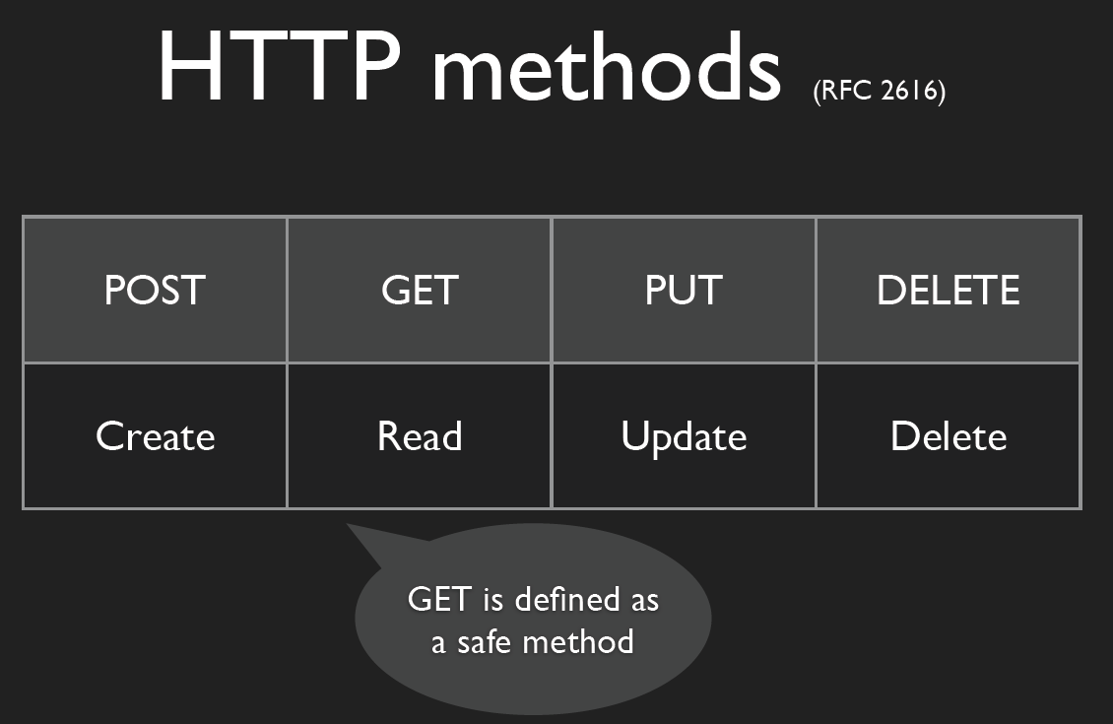
REST IN Rails

Slide 12
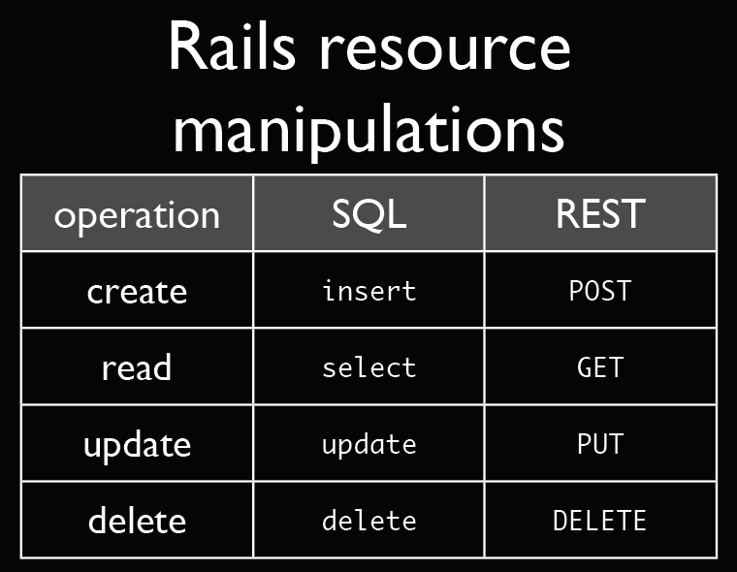
REST IN Rails

Slide 13
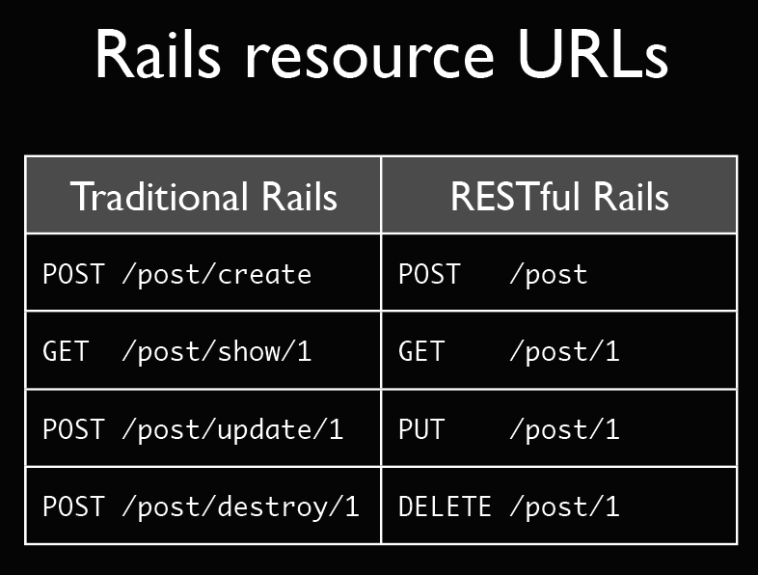
REST IN Rails

Slide 14
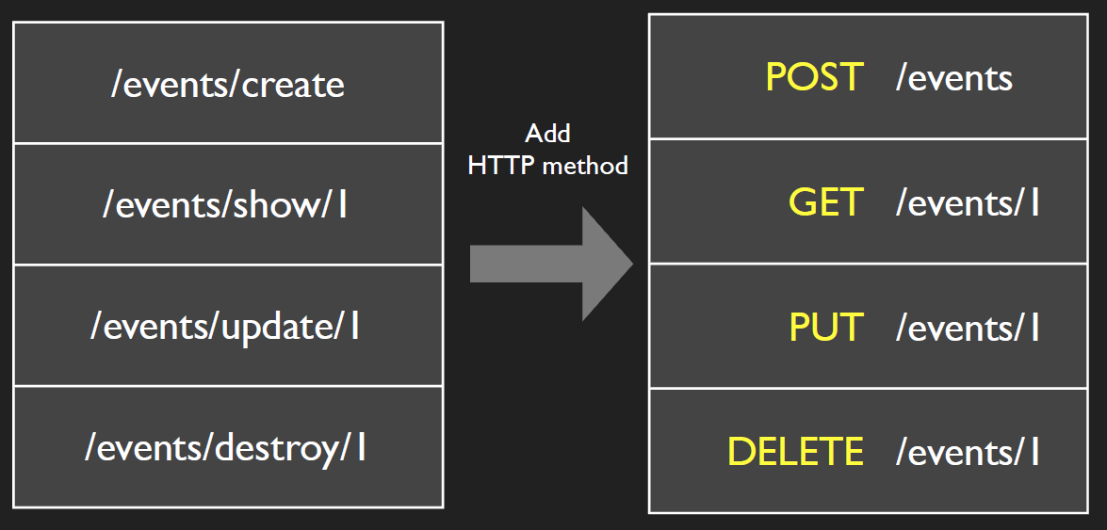
REST IN RAILS
Remove actions from URL, and we have simple named route.

Slide 15
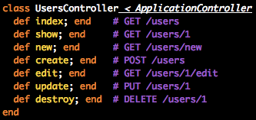
REST IN RAILS
RESTful Rails controller
A RESTful controller has 7 standard actions
Each controller deals with a resource (user) and its collection (list of users)

Slide 16
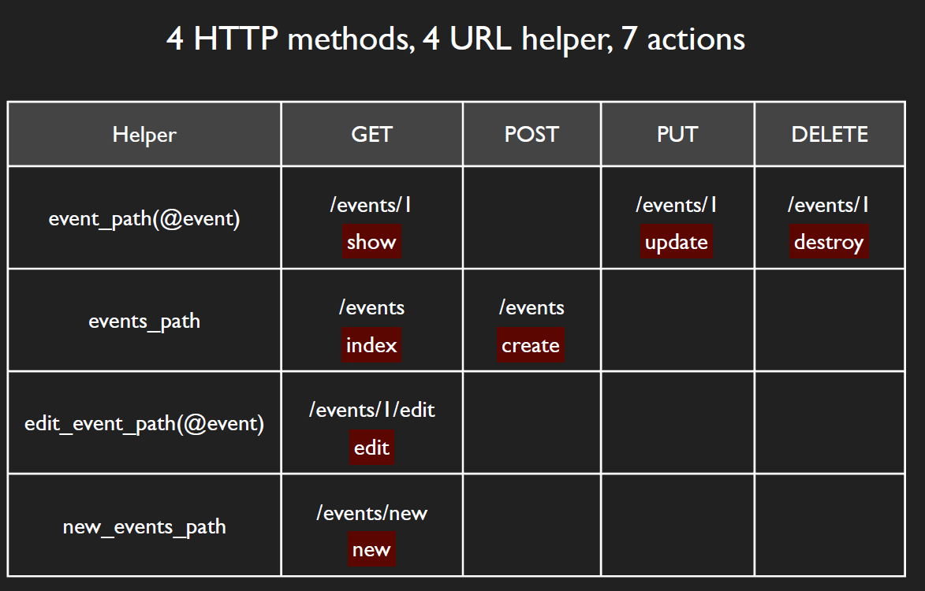
REST IN RAILS

Slide 17
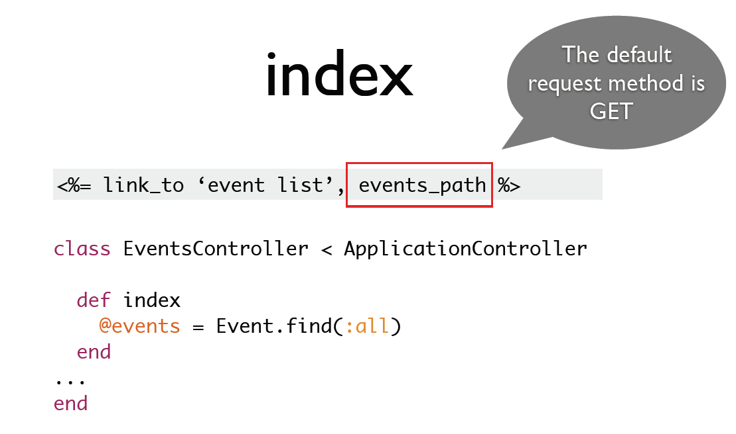
REST IN RAILS

Slide 18
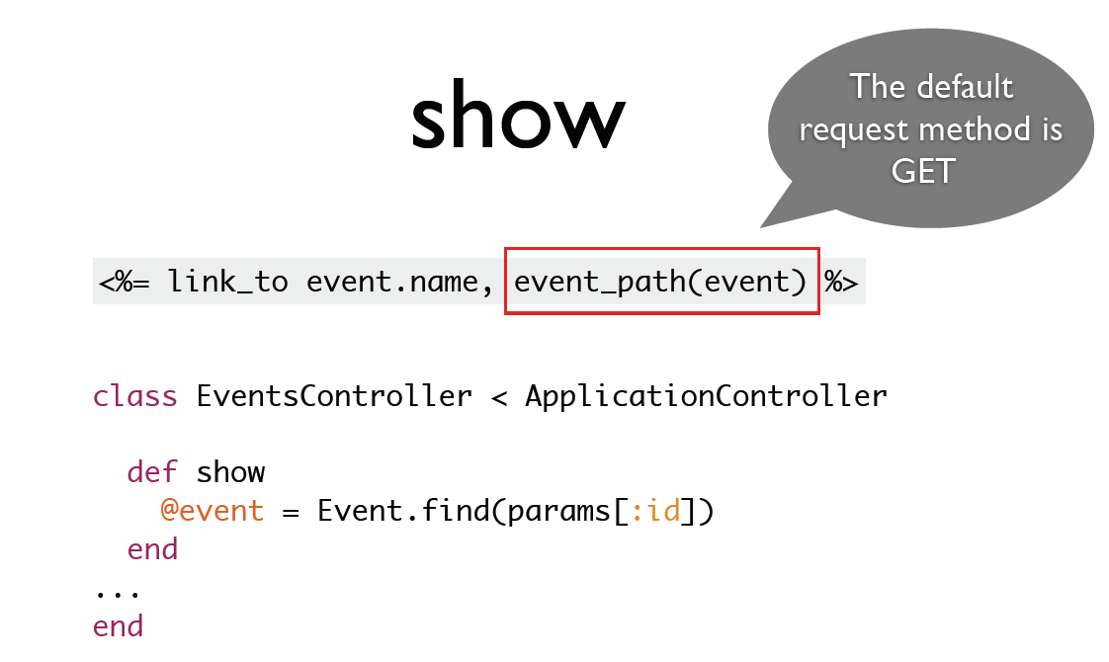
REST IN RAILS

Slide 19
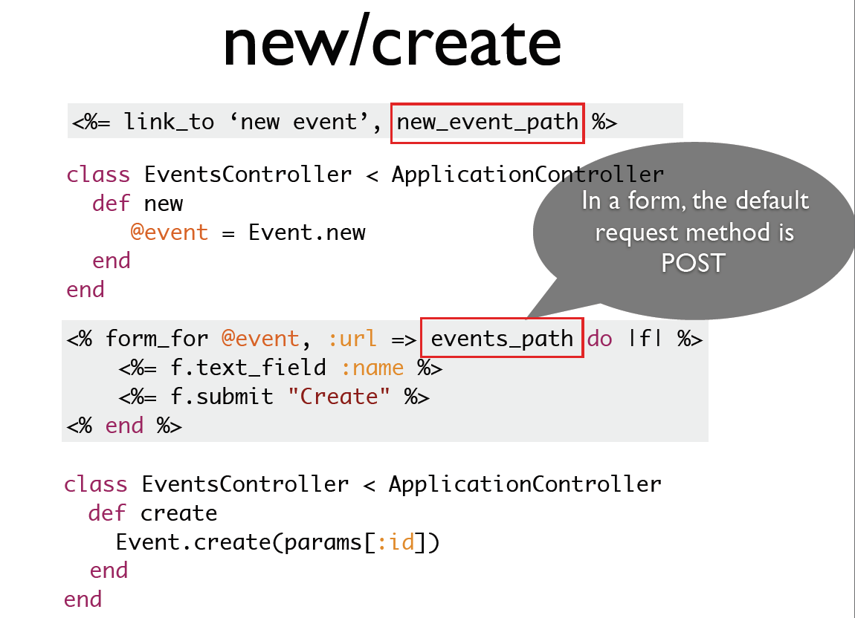
REST IN RAILS

Slide 20
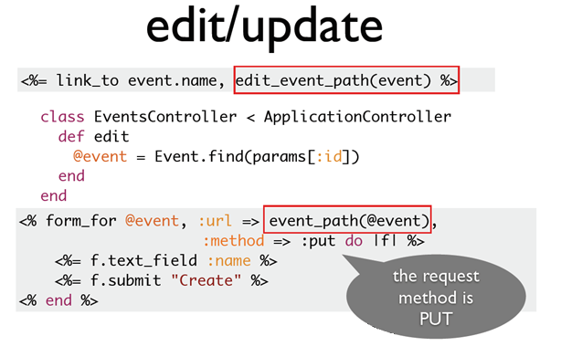
REST IN RAILS

Slide 21
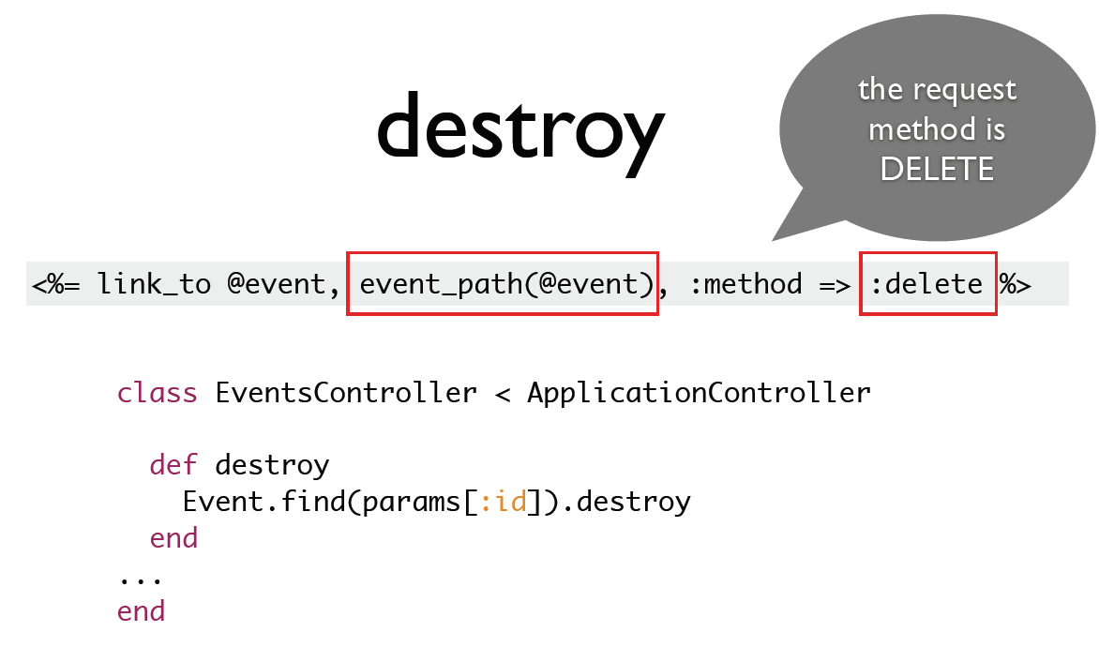
REST IN RAILS

Slide 22
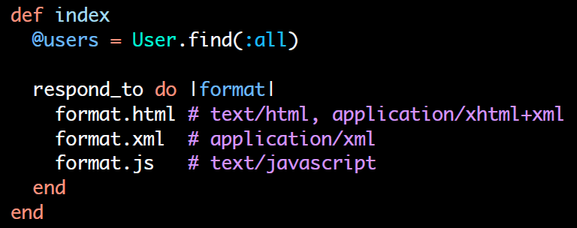
REST IN RAILS
Representation independence:
respond_to
Based on:
HTTP Accept Header
Format extension
http://www.frailers.net/articles/24/comments/1.html
http://www.frailers.net/articles/24/comments/1.js

Slide 23
REST IN RAILS
REST Routing
So far, we have explained the REST concept and a bunch of new
methods to be used in links, forms and controllers. But we haven’t yet
explained where these methods come from. Responsibility for the
existence of all these methods and the proper handling of REST
requests belongs to a new entry in the Rails routing file,
config/routes.rb :
resources :autos
resources generates the Path and URL methods for the Auto resource
Defining Multiple Resources at the Same Time
resources :photos, :books, :videos
Singular Resources
resource :profile

Slide 24
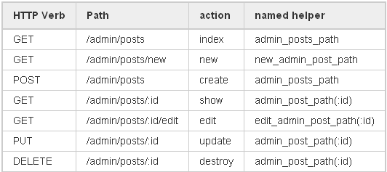
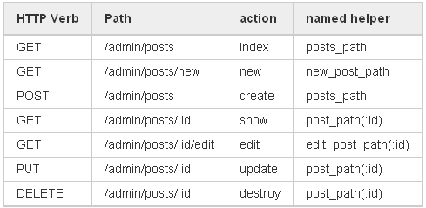
REST ROUTING
Controller Namespaces and Routing
You might group a number of administrative controllers
under an Admin:: namespace. You would place these
controllers under the app/controllers/admin directory,
and you can group them together in your router:
namespace :admin do
resources :posts, :comments
end
If you want to route /posts (without the
prefix /admin) to Admin::PostsController, you
could use
scope :module => "admin" do
resources :posts, :comments
end

Slide 25
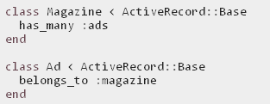

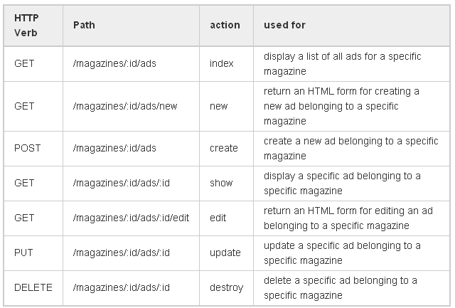
REST ROUTING
Nested Resources

Slide 26
REST ROUTING
Creating Paths and URLs From Objects
= link_to "Ad details", magazine_ad_path(@magazine, @ad)
= link_to "Ad details", url_for([@magazine, @ad])
= link_to "Ad details", [@magazine, @ad]

Slide 27
REST ROUTING
More RESTful Actions
You are not limited to the seven routes that RESTful routing creates by default. If you like,
you may add additional routes that apply to the collection or individual members of the
collection.
Member (/photos/1/preview)
resources :photos do
member do
get 'preview'
end
End
Collection (/photos/search)
resources :photos do
collection do
get 'search'
end
end

Slide 28
DOCS & LINKS
http://guides.rubyonrails.org
http://rusrails.ru
RESTful Rails Development (Ralf Wirdemann/Thomas Baustert)
Copyright © 2012 SoftServe, Inc.

Slide 29
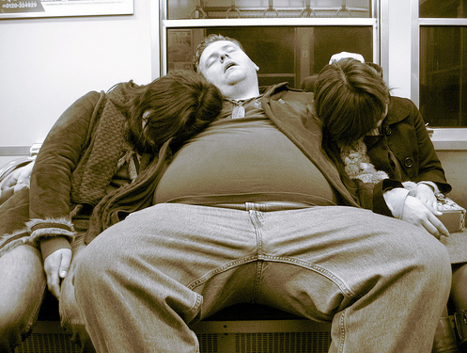
THANK YOU!
Copyright © 2012 SoftServe, Inc.

